Slide 1



University of Hawaii at Manoa
Honolulu, Hawaii
Presenter: Michael Bristol

Slide 2
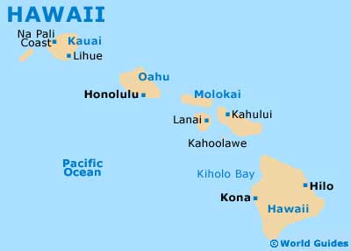
Where is the University Located?

Slide 3



Why Consider University of Hawaii
Ranked as one of the best buys
Enrolls students from around the world
Offers a mild climate and breathtaking scenery

Slide 4
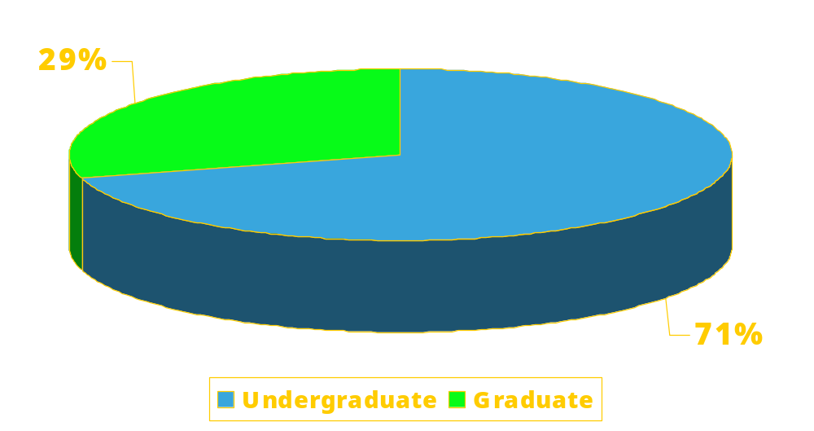
What is the Student Population?

Slide 5

What are the Requirements?
HS Diploma
Mean GPA 3.35
Mean SAT
1088
Mean Act
23

Slide 6
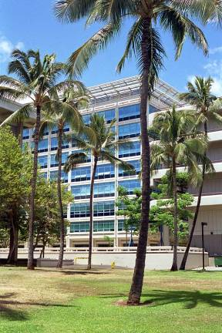
What Do We Offer?
Bachelors in 88 fields
Masters in 87 fields
Doctorates in 53 fields
Student faculty ratio 14:1

Slide 7
What are the Costs?
 | In-State | Out-of-State
Tuition & Fees | 6,257 | 16,915
Room & Board | 7,564 | 7,564
Books & Supplies | 1,167 | 1,167
Total | 14,988 | 25,646

Slide 8



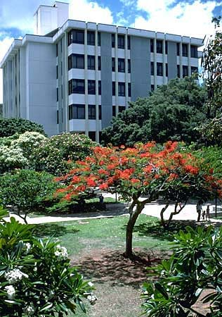
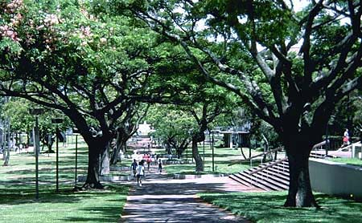
What Does the Area Offer?

Slide 9
Why Wait? Apply Today!
http://www.communications.hawaii.edu/
Regular application deadline: 01-May
Priority application deadline: 01-Feb
Rolling notification beginning: 01-Dec
Student must apply to acceptance by 01=May or within 2 weeks
Financial aid priority deadline: 01-May
Housing deposit deadline: 01-May

Slide 10
Any Questions?
Where is the University Located?
Why Consider University of Hawaii
What is the Student Population?
What are the Requirements?
What Do We Offer?
What are the Costs?
What Does the Area Offer?
Why Wait? Apply Today!

Slide 11

How to Embed YouTube Videos

